Slide 1
Entwicklung einer Digital Twin-Applikation für einen Industrieroboter mit ROS und OPC-UA
Ahmed Ibrahim Almohamed
ibraah03@thu.de

Slide 2
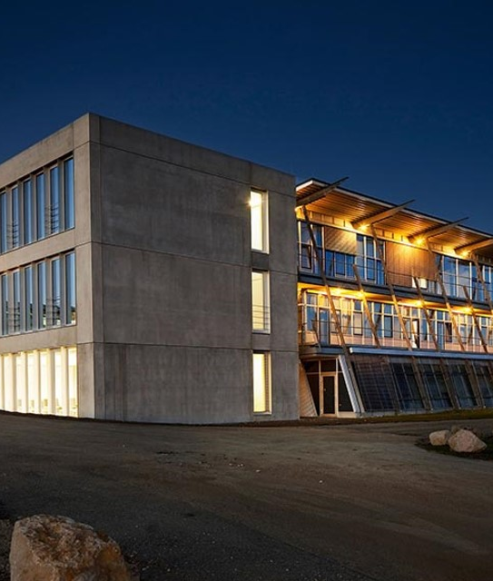
Agenda
Project definition
Technical Foundations
System Architecture
System Workflow
Use Case (Virtual Commissioning)
Areas for Improvement

Slide 3
Project Definition
Connection of the Kuka KR3 to ROS2
Further development of the ROS laboratory test for physical Kuka KR3
Implementation of a DT application
Specification of an integrated ROS controller for a robot cell
Analyzing application scenarios for digital twins and industrial robots

Slide 4
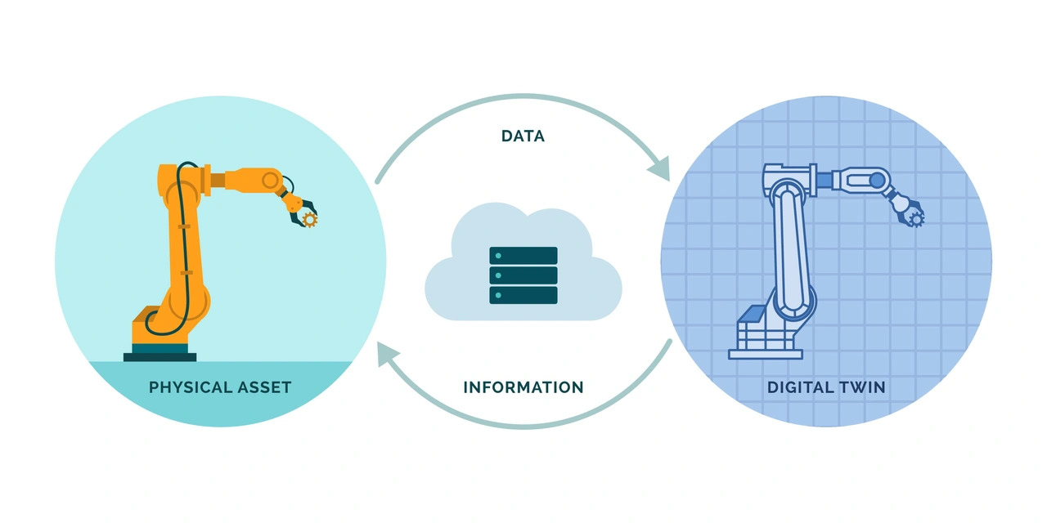
Technical Foundations
Digital Twin
Notes:
What is a DT ?
represents the creation of a virtual replica of a physical object or system that is used to simulate, monitor, and optimize its real-world counterpart.

Slide 5
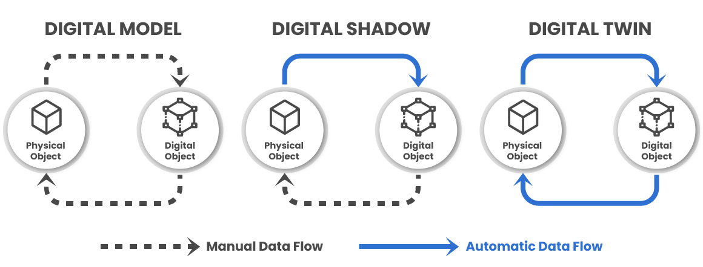
Technical Foundations
Level of Integration
Notes:
Layers of integration :
Mirroring or Digital Model : Digital representation of a physical entity
Digital Shadow : Physical to virtual uni-directional information flow
Digital Twin : virtual to physical bi-directional information flow

Slide 6
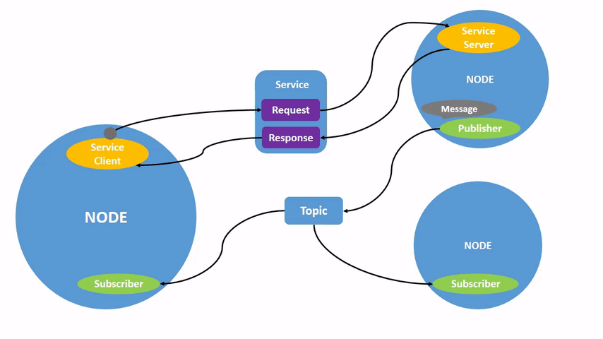
Technical Foundations
ROS2 Nodes
Notes:
ROS2 Nodes :
A node is a participant in the ROS 2 graph, which uses a client library to communicate with other nodes. Nodes can communicate with other nodes within the same process, in a different process, or on a different machine. Nodes are typically the unit of computation in a ROS graph; each node should do one logical thing.
Nodes can publish to named topics to deliver data to other nodes, or subscribe to named topics to get data from other nodes. They can also act as a service client to have another node perform a computation on their behalf, or as a service server to provide functionality to other nodes.

Slide 7
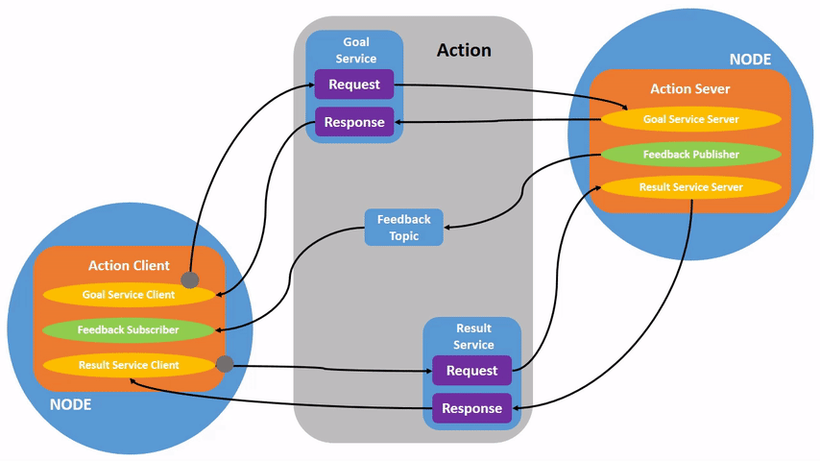
Technical Foundations
ROS2 Actions
Notes:
Actions are one of the communication types in ROS 2 and are intended for long running tasks. They consist of three parts: a goal, feedback, and a result.
Actions are built on topics and services. Their functionality is like services, except actions are preemptable (you can cancel them while executing). They also provide steady feedback, as opposed to services which return a single response.
Actions use a client-server model, like the publisher-subscriber model. An “action client” node sends a goal to an “action server” node that acknowledges the goal and returns a stream of feedback and a result.

Slide 8
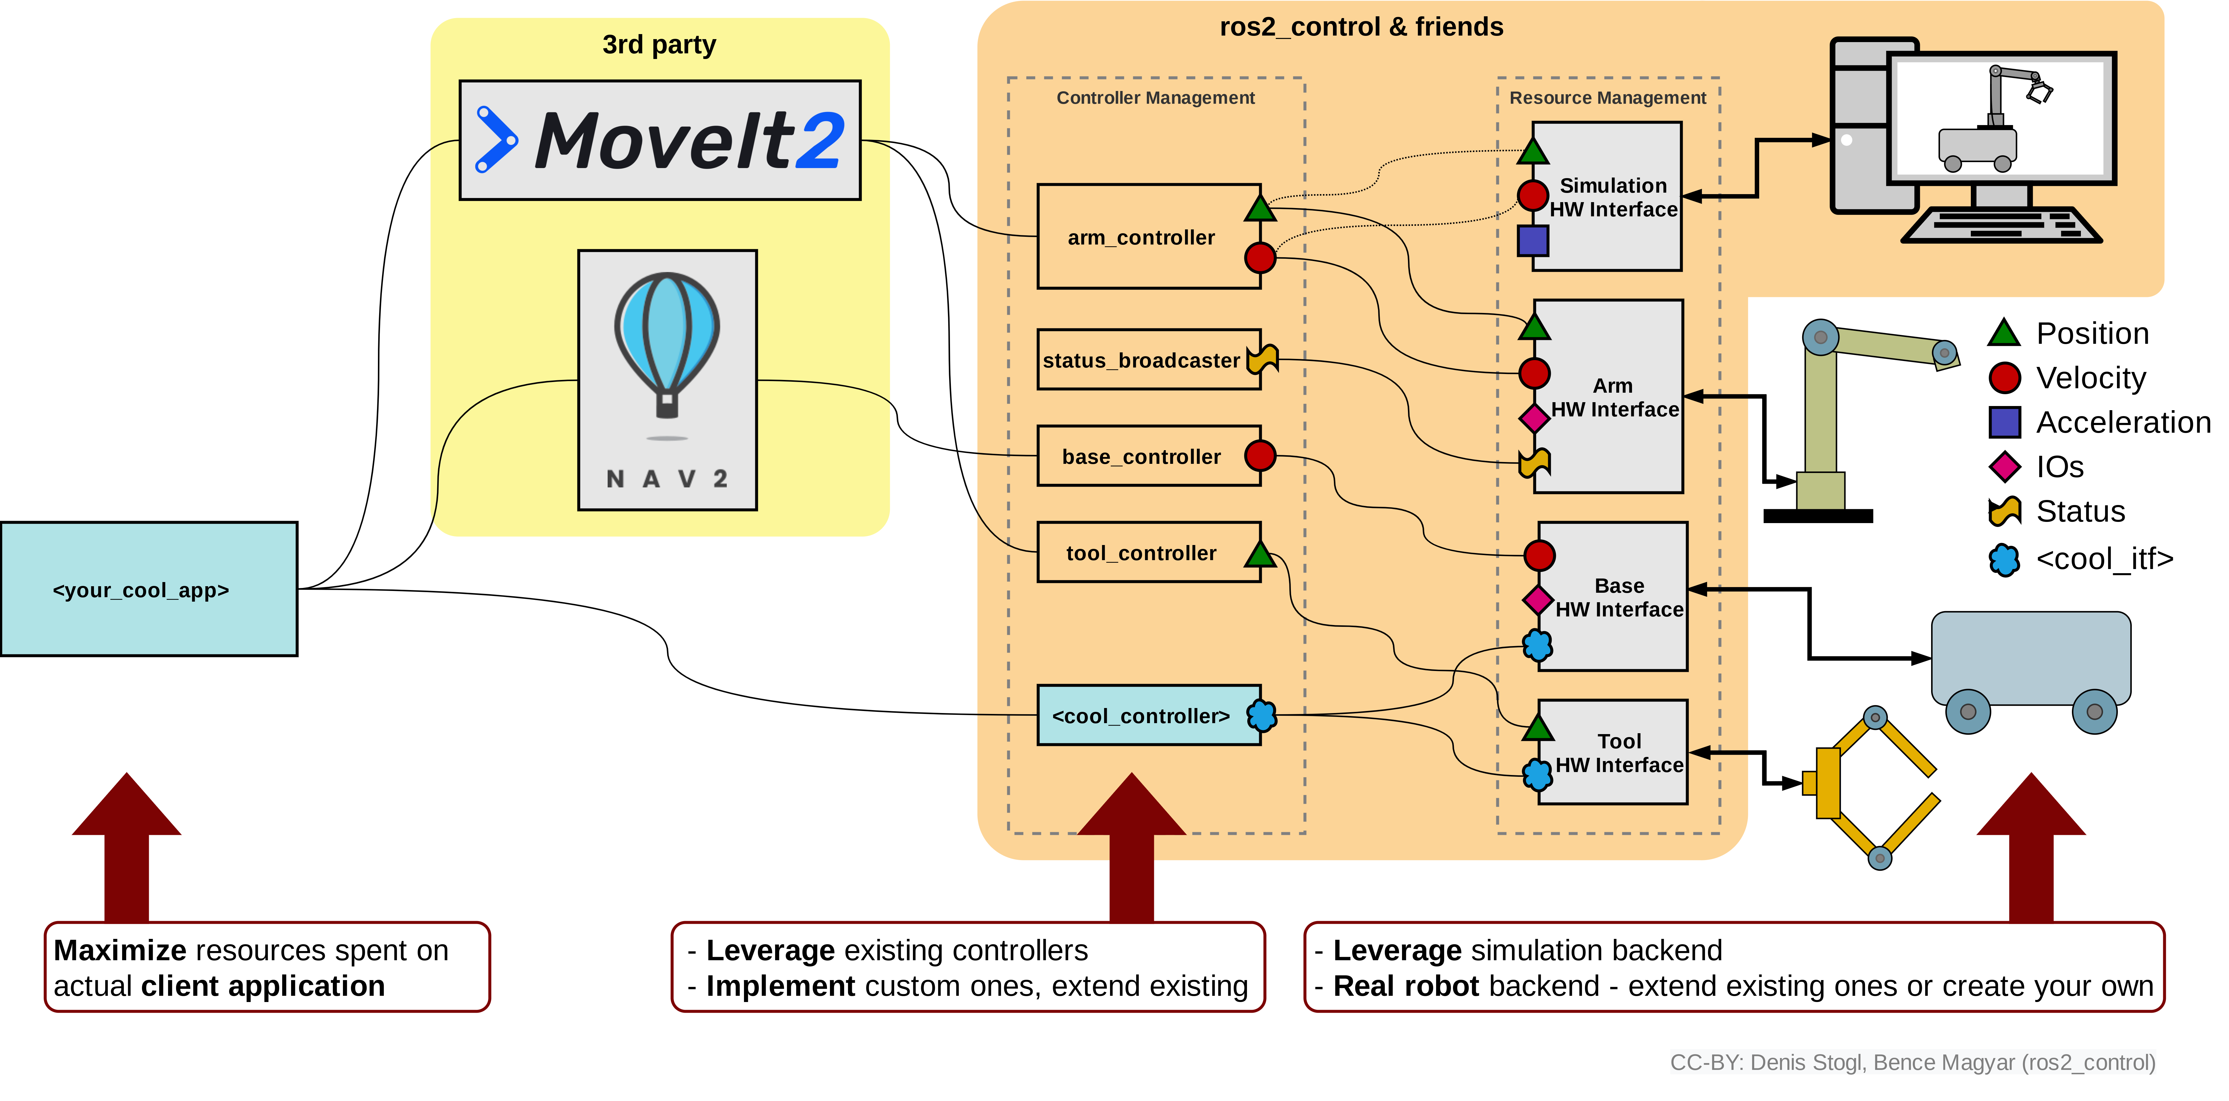
Technical Foundations
ROS2 Robotics Workflow
Notes:
ROS2 Layers :
App Layer : where the high level commands come ( RVIZ or some ros2 node )
3rd party software : like Movit2 for motion planning, manipulation, 3D perception, kinematics, control, and navigation.
Controllers

Slide 9
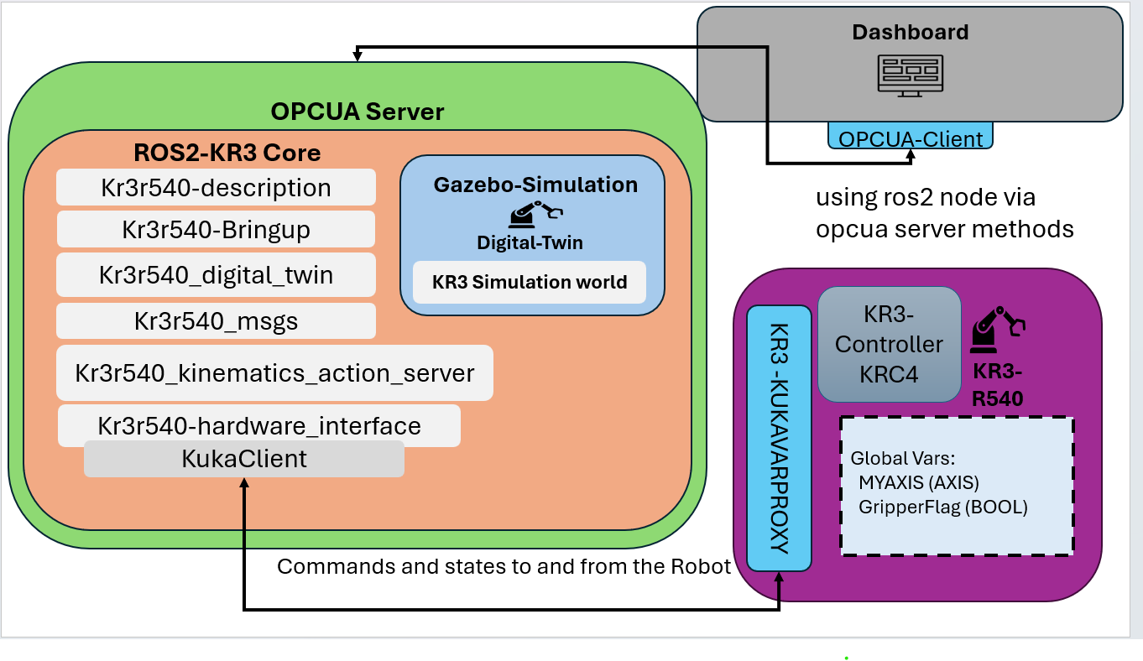
System Architecture
Notes:
System overview :

Slide 10
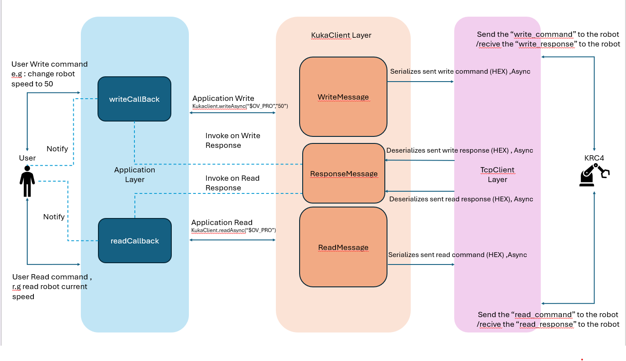
System Architecture
TCP Connection to the Robot

Slide 11
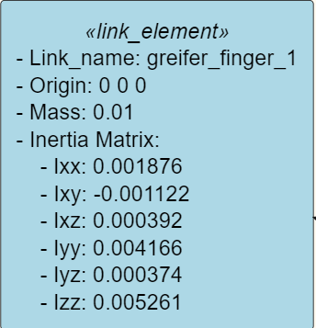
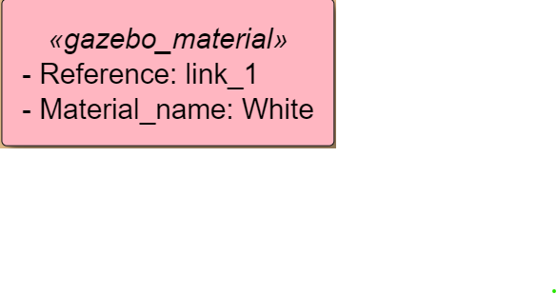
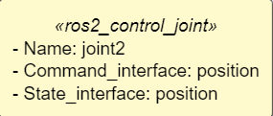

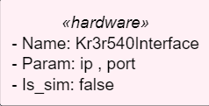
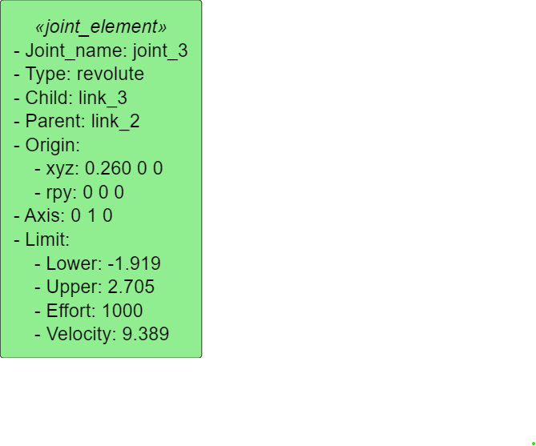
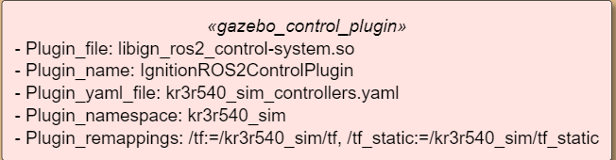
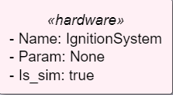
System Architecture
ROS2 Robot Description
Robot Parts
Gazebo Parts
Ros Control
URDF File

Slide 12
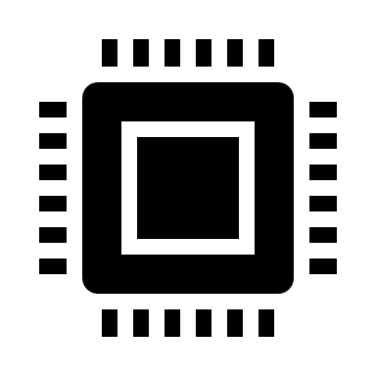
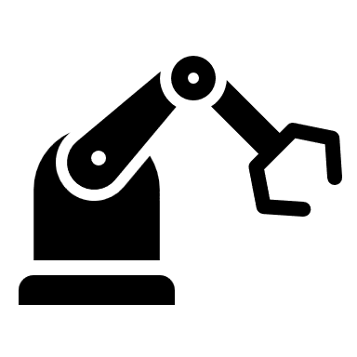

System Architecture
ROS2 Control - Overview
Kuka KR3-R540
Control Manager
Hardware Interface
Send Points to Robot
Configuration Yaml File
Joint Trajectory Controller

Slide 13
System Architecture
ROS2 Control – Joint Trajectory Controller (JTC)
JTC
Trajectory Point/s
( Joint Space !)
Interpolation Spline ( linear)
Joint Trajectory

Slide 14
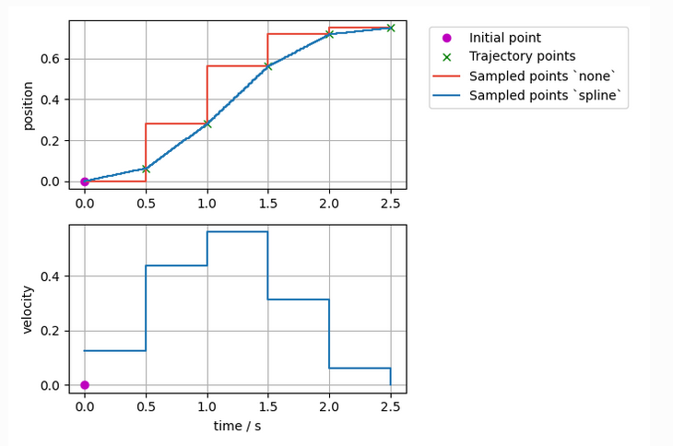
System Architecture
ROS2 Control – Joint Trajectory Controller (JTC) – example Interpolation Spline ( linear)

Slide 15
System Architecture
ROS2 Kinematics
Inverse Kinematics Action Server
Points in cartesian Space
Points in Joint Space
Using Levenberg-Marquardt Method (KDL Library)

Slide 16
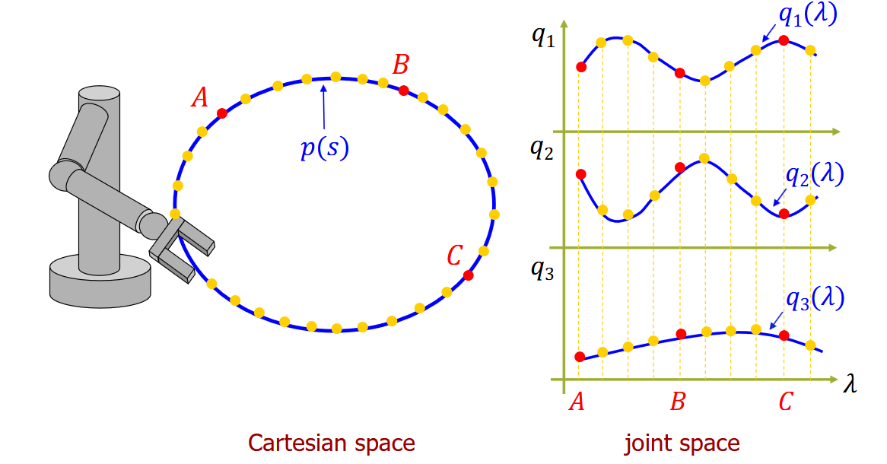
System Architecture
ROS2 Kinematics - Example

Slide 17
System Architecture
ROS2 Kinematics
Forward Kinematics – Publisher Node
Joint Space Points
Cartesian Space points
Using recursive forward position kinematics algorithm

Slide 18
System Architecture
Path Planning Sequence
Those steps are not implemented into the system , could be implemented in the future
Sequence of Pose points in Cartesian Space
Interpolation in Cartesian space
Cartesian geometric path ( position and orientation )
Path sampling and inverse kinematic
Sequence of Pose points in Joint space
Using JTC to Interpolating them into a Trajectory
Geometric path in Joint space
Using PTP on Kuka to move the robot (only follows the point sent and dose not calculate new path )

Slide 19
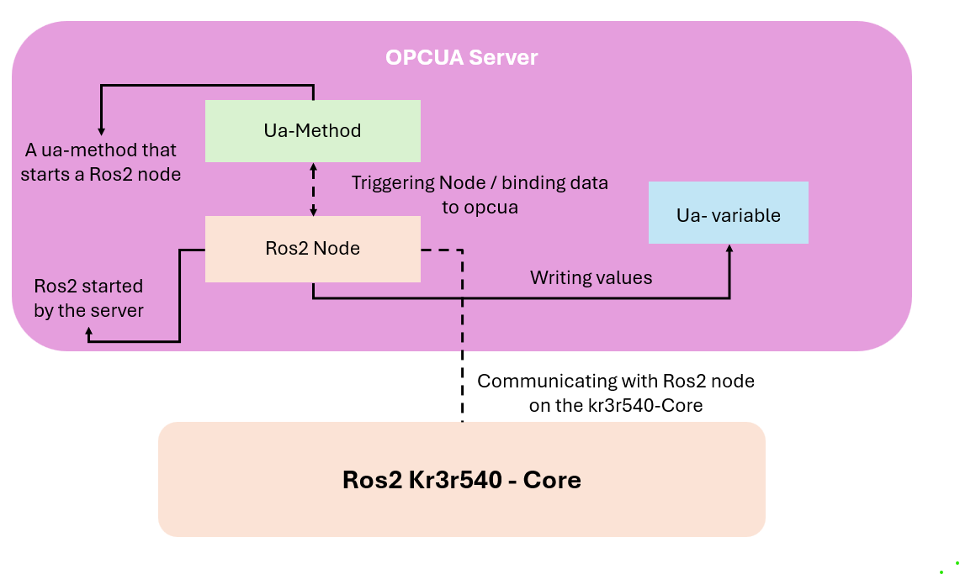
System Architecture
OPCUA Server - Overview

Slide 20
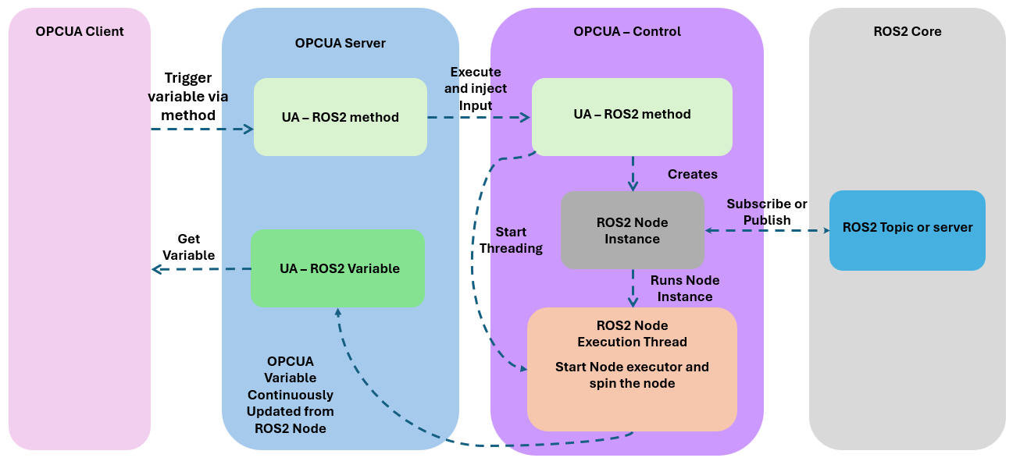
System Architecture
OPCUA Server- Workflow

Slide 21
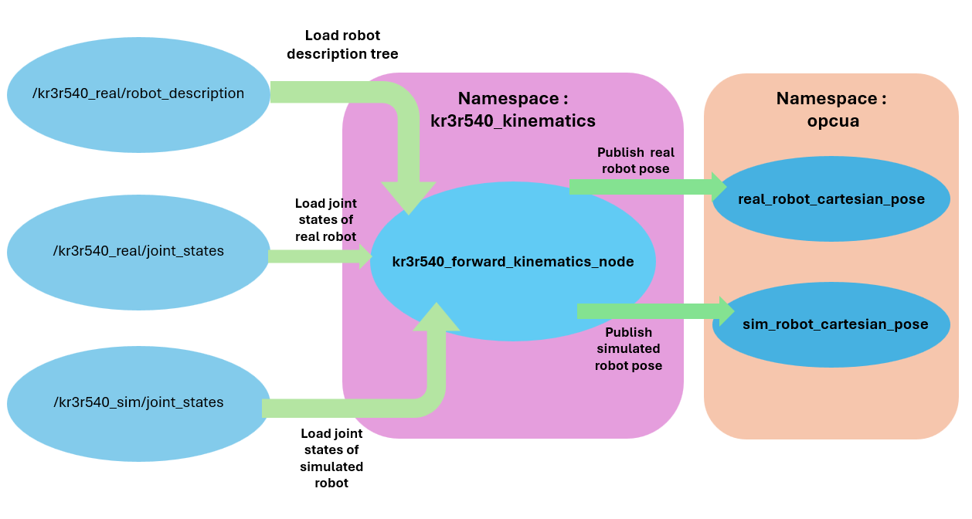
System Architecture
Digital Twin

Slide 22
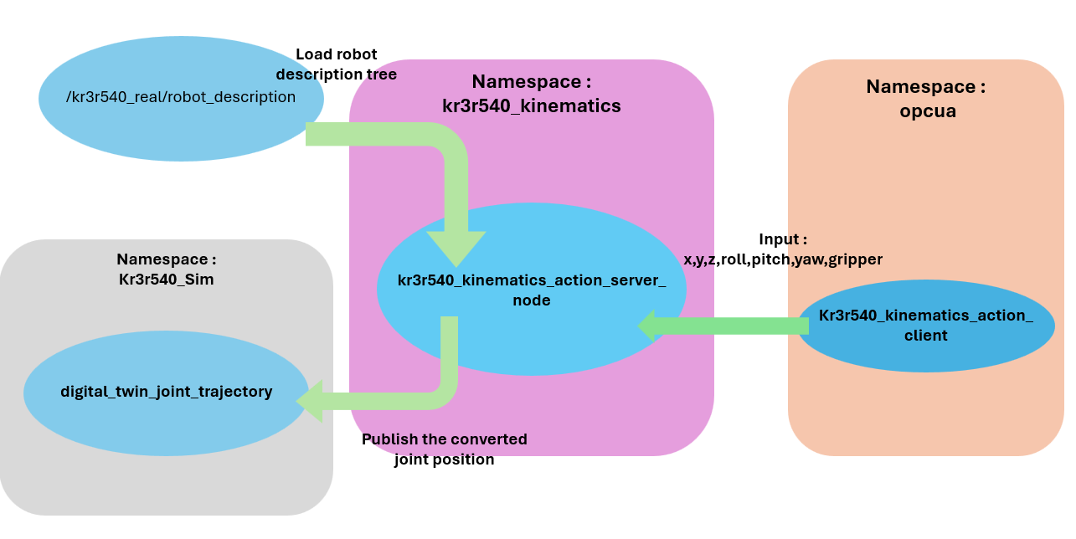
System Architecture
Digital Twin

Slide 23
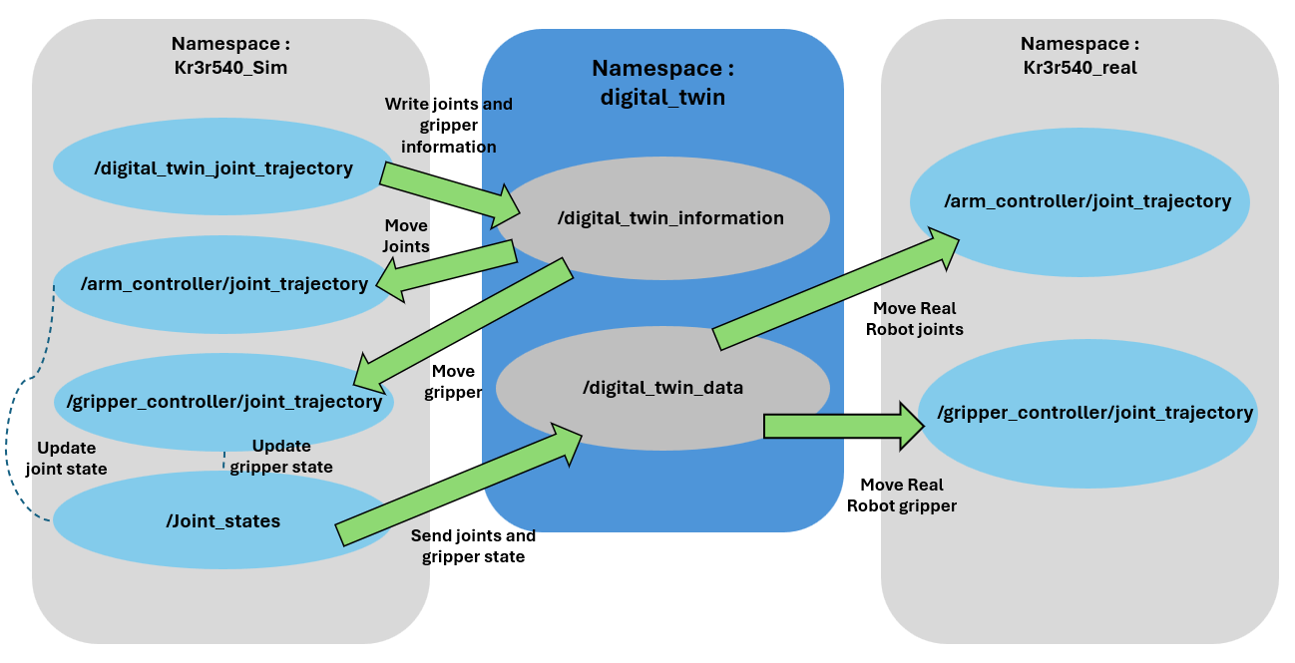
System Architecture
Digital Twin

Slide 24
System Architecture
GUI – OPCUA Client
Login and Register
Registering users with authentication functionalities
Docker Build and run
Building the system inside a docker image and run it
MongoDB as Backend
System have a Mongo database as a backend
OPCUA Client
Starting the OPCUA Client and connecting it to the Server inside the image
Robot Control
Starting the Simulation and real robot and control the DT inside the docker image

Slide 25
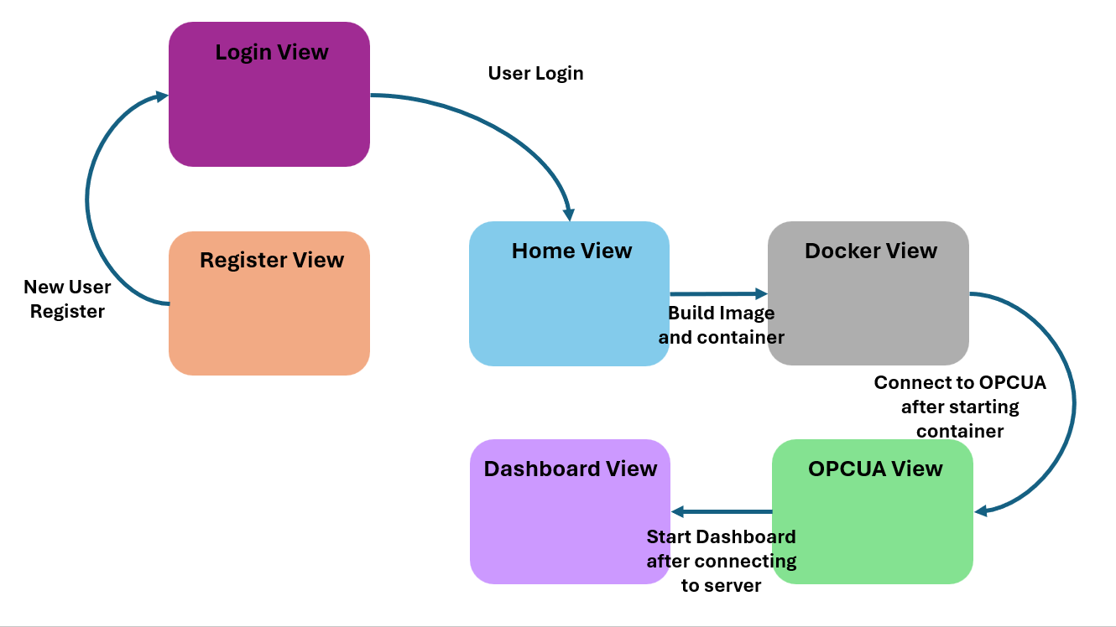
System Architecture
GUI – OPCUA Client

Slide 26
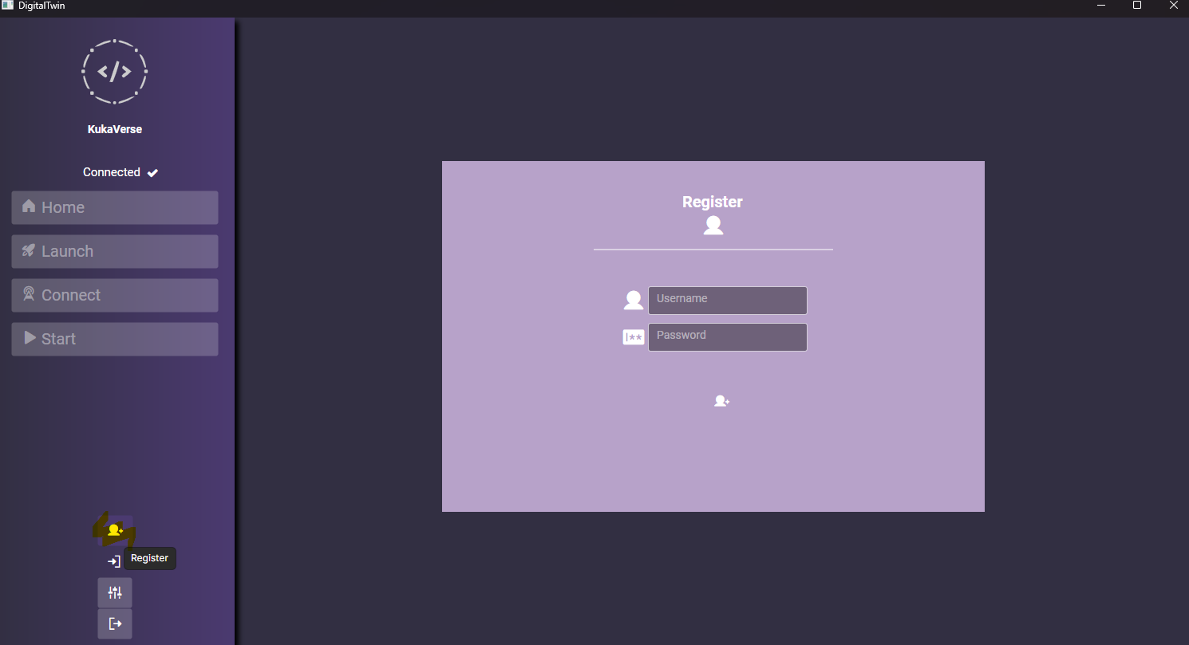
System Architecture
GUI – OPCUA Client – Register

Slide 27
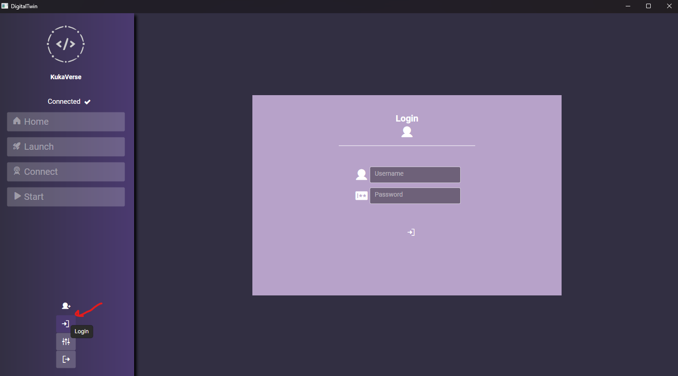
System Architecture
GUI – OPCUA Client – Login

Slide 28
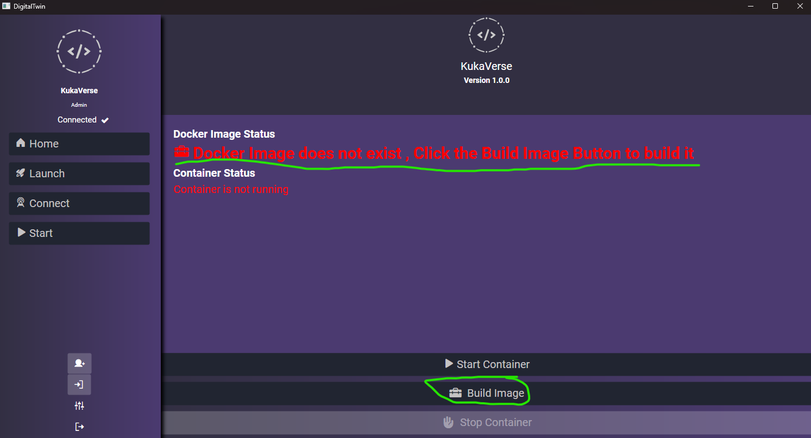
System Architecture
GUI – OPCUA Client – Docker

Slide 29
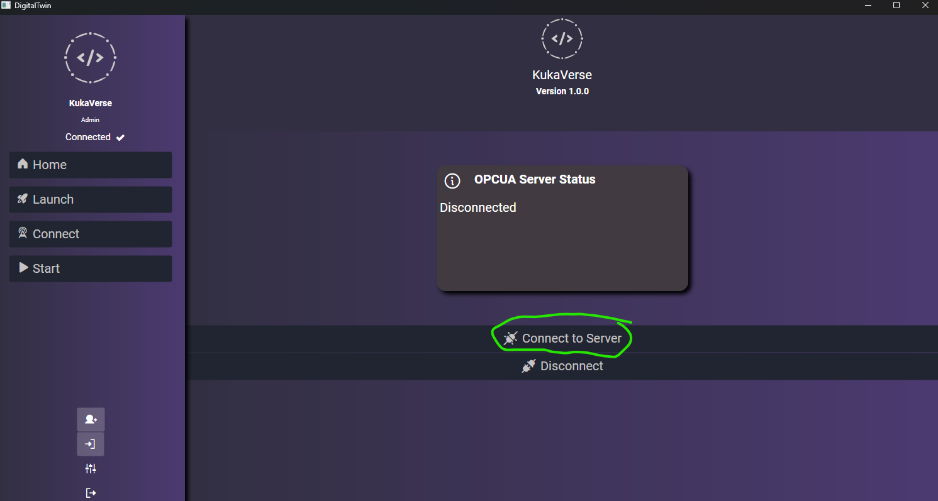
System Architecture
GUI – OPCUA Client – OPCUA Connection

Slide 30
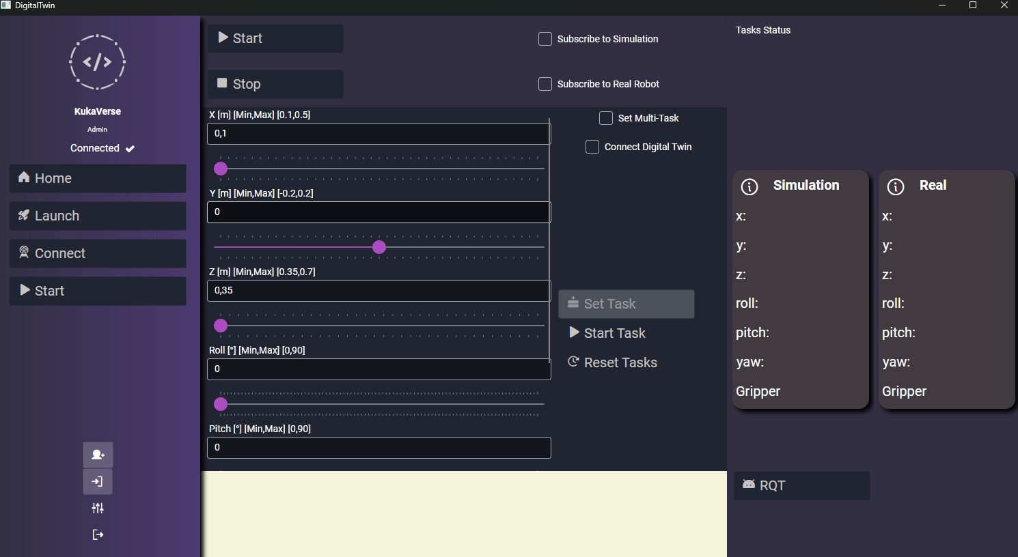
System Architecture
GUI – OPCUA Client – Dashboard

Slide 31
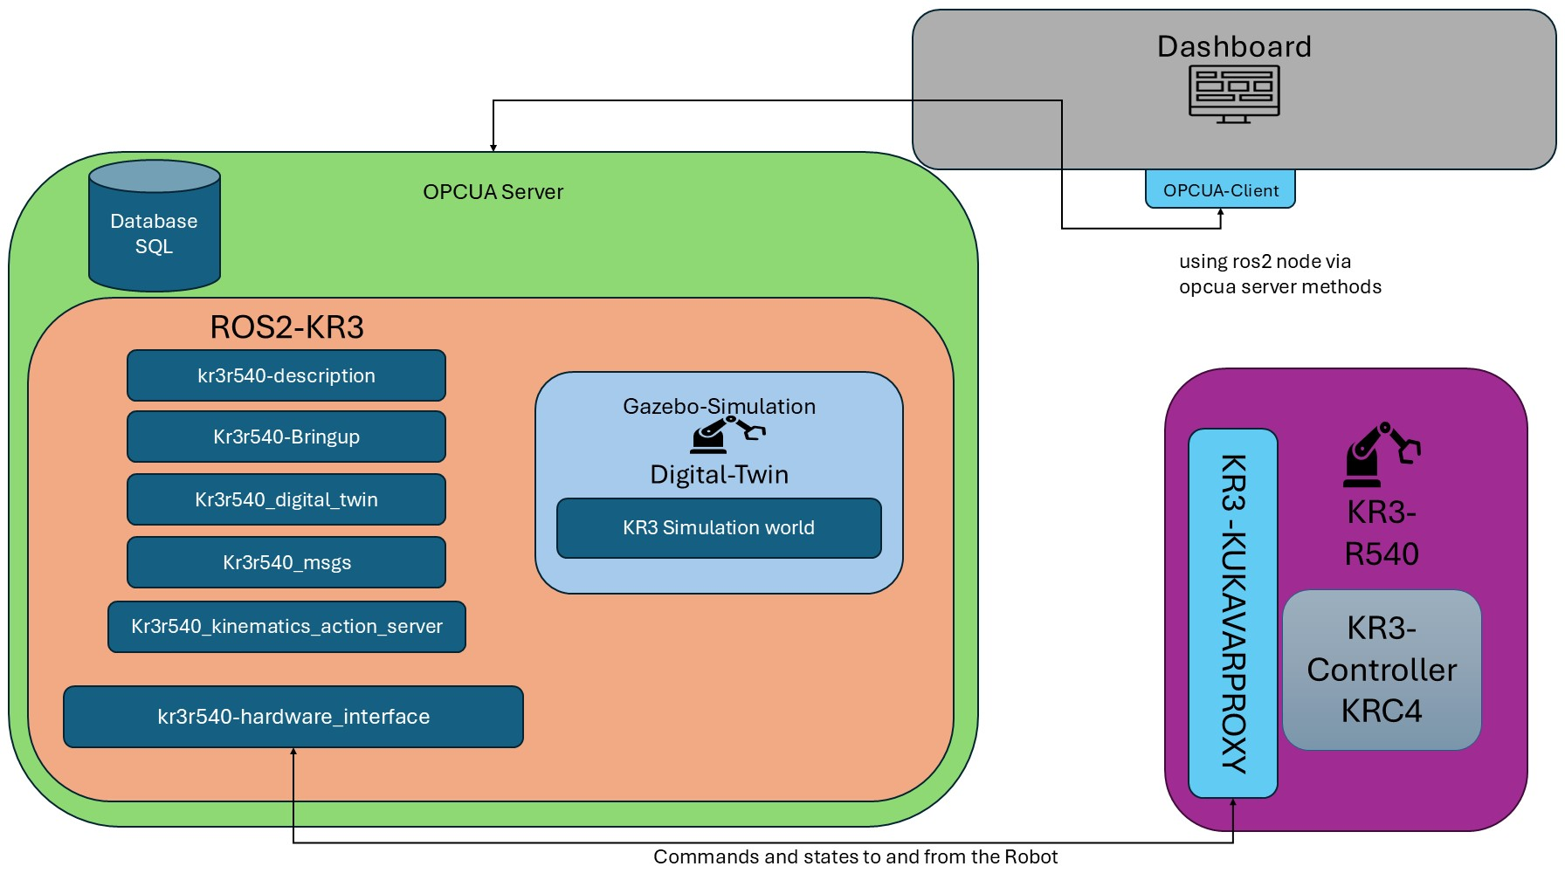
System Architecture
Docker
Running inside the Docker Image
Builds the Docker Image and runs it

Slide 32
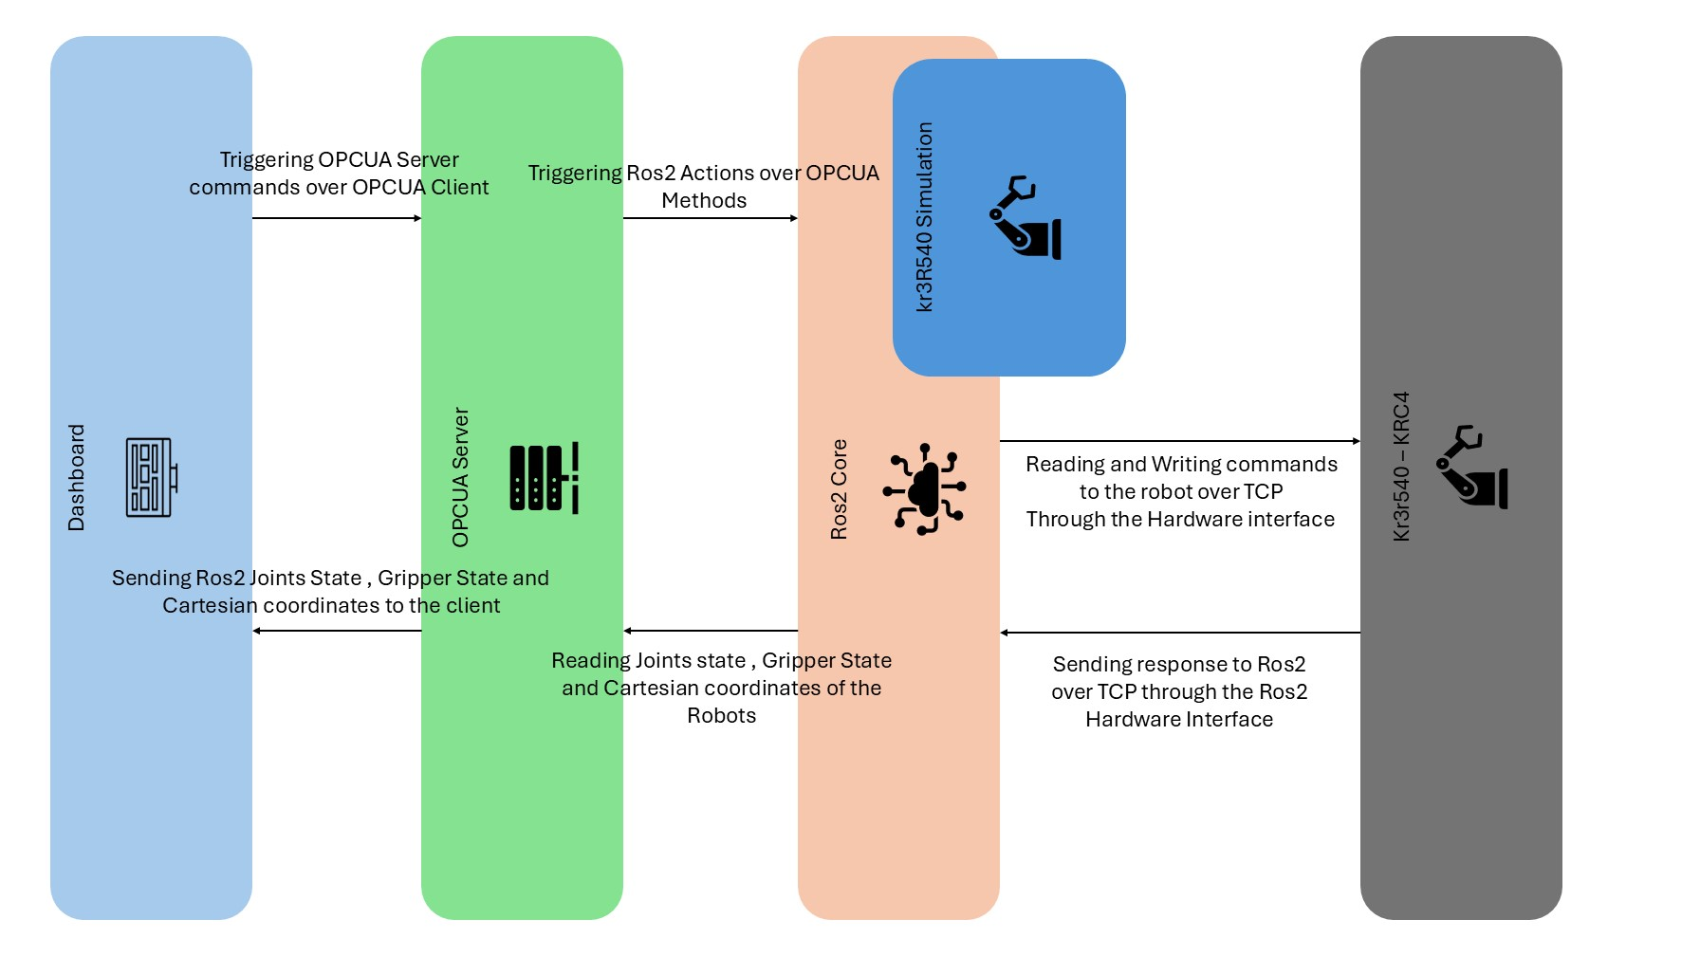
System Workflow
Overview

Slide 33
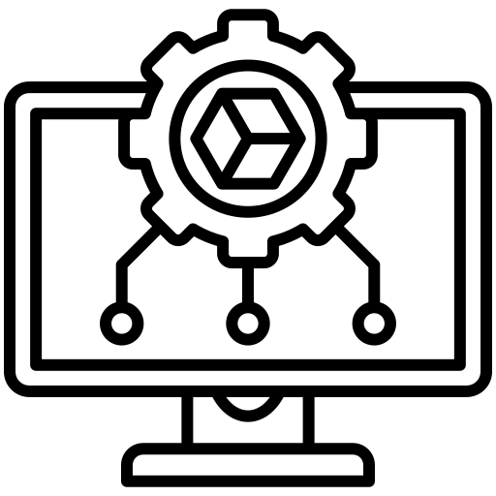


Use case – Visual Commission
Overview
Running Paths on the real robot after choosing right configurations
Testing points, paths , creating Tasks ,testing collusion
System – Simulation
System – real
User - Student
Dashboard - App
Sending Feedback from Real Robot
Sending Feedback from Simulation

Slide 34
Areas for Improvement
As Mentioned, The Path planning is missing some steps to achieve a cartesian path planning sequence
The Simulation needs some improvements , as in adding the Cabinet of the robot and all the objects inside it to create a replica of the workstation.
The system also needs an implementation of a collusion detection algorithm to help with the robot movement.
The GUI and Database could be improved by adding :
A workflow that gathers tasks together
A display for all tasks stored in the database
A better management of the Tasks inside of the database ( delete or update the Tasks are missing) , where we delete the entire Tasks of the user currently.
Maybe moving the App from a Desktop to web app is a good approach.
Changes to the controller :
Use Position and velocity interfaces so that we can use Cubic splines instead of linear ( smoother movement of the robot )
Expanding the Hardware interface to support the velocity interface so that it can control the real robot joints velocity

Slide 35
DEMO

Slide 36
Vielen Dank für Ihre Aufmerksamkeit.
www.thu.de

